Slide 1
Movielens 27m
Dataset analysis using HDP, Hive, Power BI and Azure ML

Slide 2
Table of contents
1 – Configuring HDP sandbox 2.6.5
2 – Configuring Hive
2.1 – Create database and external tables (movielens_external)
2.2 – Define DW model and queries for data ingestion
2.3 – Create optimized DW database and tables (movielens)
3 – Power BI and Azure ML
3.1 – Hive ODBC connection
3.2 – Azure ML connection
3.3 – Power BI ⬄ Azure ML
4 – Movielens analysis

Slide 3
STEP 1 Configuring HDP sandbox 2.6.5
1.1 – Run HDP in VM of choice (in our case VMWare)
1.2 – Copy dataset files to HDP system using WinSCP
1.3 – Put files in HDFS using SSH and HDFS commands. Place the .csv files in specific folders to make Hive HQL development easier
ssh maria_dev@192.168.145.145 -p 2222
hadoop fs -copyFromLocal /home/maria_dev/movielens/movies.csv /home/maria_dev/movielens/movies/
hadoop fs -copyFromLocal /home/maria_dev/movielens/tags.csv /home/maria_dev/movielens/tags/
hadoop fs -copyFromLocal /home/maria_dev/movielens/genome-tags.csv /home/maria_dev/movielens/genome-tags/
hadoop fs -copyFromLocal /home/maria_dev/movielens/genome-scores.csv /home/maria_dev/movielens/genome-scores/
hadoop fs -copyFromLocal /home/maria_dev/movielens/ratings.csv /home/maria_dev/movielens/ratings/
hadoop fs -copyFromLocal /home/maria_dev/movielens/links.csv /home/maria_dev/movielens/links/

Slide 4
STEP 2 Configuring Hive
Create database and external tables (movielens_external)
Define DW model and queries for data ingestion
Create optimized DW database and tables (movielens)

Slide 5
STEP 2.1 Configuring Hive - Create external tables
create database if not exists movielens_external;
use movielens_external;
create external table if not exists genome_scores (
movieId int,
tagId int,
relevance decimal
)
ROW FORMAT DELIMITED
FIELDS TERMINATED BY ','
STORED AS TEXTFILE
location '/user/maria_dev/movielens/genome-scores'
tblproperties ("skip.header.line.count"="1");
create external table if not exists genome_tags (
tagId int,
tag string
) ROW FORMAT DELIMITED
FIELDS TERMINATED BY ','
STORED AS TEXTFILE
location '/user/maria_dev/movielens/genome-tags'
tblproperties ("skip.header.line.count"="1");
create external table if not exists links (
movieId int,
imdbId string,
tmdbId int
) ROW FORMAT DELIMITED
FIELDS TERMINATED BY ','
STORED AS TEXTFILE
location '/user/maria_dev/movielens/links'
tblproperties ("skip.header.line.count"="1");
create external table if not exists movies (
movieId int,
title string,
genres string
) ROW FORMAT SERDE 'org.apache.hadoop.hive.serde2.OpenCSVSerde'
WITH SERDEPROPERTIES (
"separatorChar" = ",",
"quoteChar" = "\""
)
STORED AS TEXTFILE
location '/user/maria_dev/movielens/movies'
tblproperties ("skip.header.line.count"="1");
create external table if not exists tags (
userId int,
movieId int,
tag string,
tmstmp bigint
) ROW FORMAT DELIMITED
FIELDS TERMINATED BY ','
STORED AS TEXTFILE
location '/user/maria_dev/movielens/tags'
tblproperties ("skip.header.line.count"="1");
create external table if not exists ratings (
userId int,
movieId int,
rating decimal,
tmstmp bigint
) ROW FORMAT DELIMITED
FIELDS TERMINATED BY ','
STORED AS TEXTFILE
location '/user/maria_dev/movielens/ratings'
tblproperties ("skip.header.line.count"="1");

Slide 6
STEP 2.2 Define DW model and queries for data ingestion
Using the Hive query view 2.0, we built several queries to feed our model
Once the queries where developed and tested, we created all the DDL using the following model:
dim_users
pk_userid
dim_date
pk_datekey
dim_movies
pk_movieid
fact_ratings
fk_userid fk_movieid fk_datekey fk_timekey
dim_moviegenres
fk_movieid fk_genreid
dim_time
pk_timekey
dim_genres
pk_genreid
fact_tags
fk_userid fk_movieid fk_datekey fk_timekey

Slide 7
STEP 2.3 Create optimized DW database and tables (movielens) 6 query optimization techniques used
Technique #1: Use Tez
set hive.execution.engine=tez;
Technique #2: Use ORCFile
CREATE TABLE A_ORC ( ... ) STORED AS ORC tblproperties (“orc.compress" = “SNAPPY”);
Technique #3: Use Vectorization
set hive.vectorized.execution.enabled = true; set hive.vectorized.execution.reduce.enabled = true;
Technique #4: cost based query optimization
set hive.cbo.enable=true; set hive.compute.query.using.stats=true; set hive.stats.fetch.column.stats=true; set hive.stats.fetch.partition.stats=true;
analyze table XXXXX compute statistics;
Technique #5: clustering and dynamic partitioning
CLUSTERED BY (XXXX) SORTED BY (XXXX) INTO XX BUCKETS
set hive.exec.dynamic.partition=true; set hive.exec.dynamic.partition.mode=nonstrict; PARTITIONED BY (a_year int)
Technique #6: write good SQL and use UDFs
explode(), posexplode(), LATERAL VIEW

Slide 8
STEP 2.3 Create optimized DW database and tables (movielens) DW hql scripts structure
--Optimizations and dynamic partitioning set hive..
--Set name of table to create as variable set hivevar:table_name=XXXX;
--Create DW database if not exists and use it create database if not exists movielens; use movielens;
CREATE TABLE IF NOT EXISTS ${table_name} ( … ) --Clustering and partitioning definitions here if applicable ROW FORMAT DELIMITED FIELDS TERMINATED BY ',’ STORED AS ORC tblproperties ("orc.compress" = "SNAPPY");
--Insert query results
INSERT OVERWRITE TABLE ${table_name} --partition (XXX)
select ( …) from movielens_external.XXXX;

Slide 9
STEP 3 Power BI and Azure ML

Slide 10
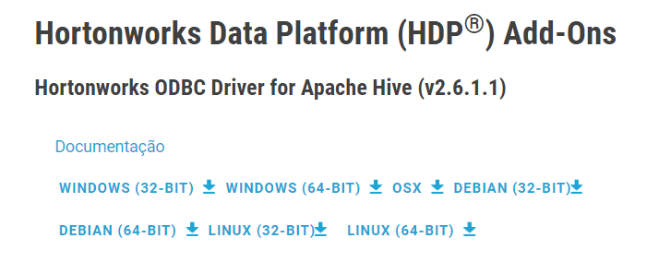
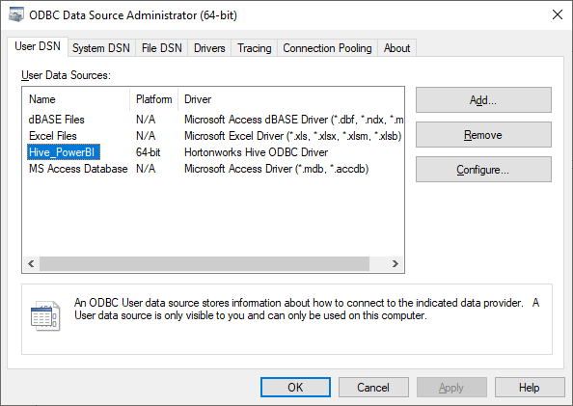
STEP 3.1 Hive ODBC Connection
3.1.1 – Download and install HDP ODBC driver
3.1.2 – Check if ODBC driver is available in our system
3.1.3 – Use the Hive connector in Power BI

Slide 11
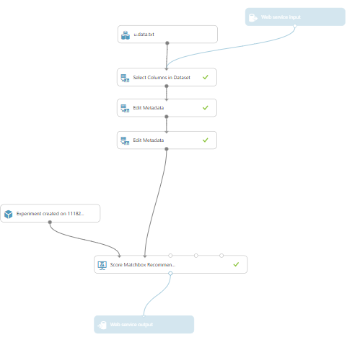
STEP 3.2 Azure ML Model
3.2.1 – Upload dataset to Azure ML
3.2.2 – Create a Matchbox recommender model
3.2.3 – Save as a web service (see image)
3.2.4 – Use and adapt generated REST R code

Slide 12
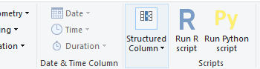
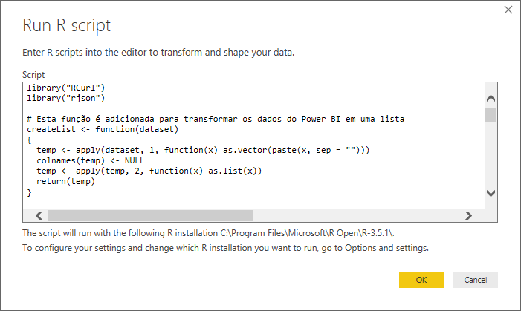
STEP 3.3 Power BI ⬄ Azure ML
3.3.1 – Get data from Hive 3.3.2 – Duplicate the table in Power BI Query Editor 3.3.3 – Develop and test our R script in Rstudio 3.3.4 – Deploy the R Custom Script in Power BI Query Editor

Slide 13
STEP 4 Movielens Analysis

